Slide 1





Reported Speech in U̱t-Maꞌin
Rebecca Paterson CNRS-LLACAN and SIL International
A data oriented workshop: The grammatical variation of reported speech across languages 12 Nov 2020 – online session – University of Helsinki

Slide 2
Main goals of this talk
Review the main strategies for speech reporting in U̱t-Maꞌin.
zɘ̄ ‘say’ construction
Speech Verb Phrase + ɘ̄zɘ̄ ‘saying’ constructions
Observe a range of extended uses of the morpheme ɘ̄zɘ̄.
Discuss mono-clausal versus bi-clausal status of ɘ̄zɘ̄ constructions (as time allows)
Constituency
Prosodic boundary phenomena

Slide 3
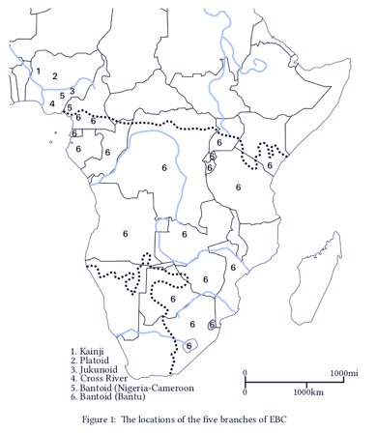
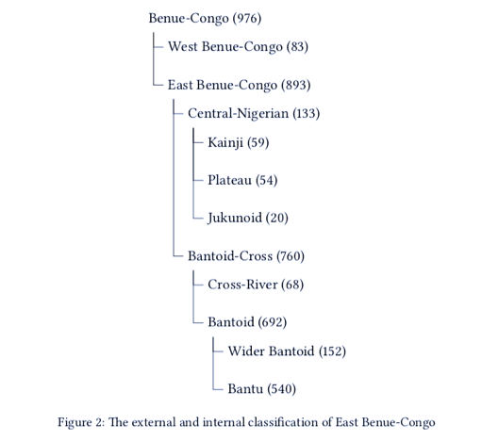
Introduction – Kainji Languages
Kainji location and classification
within East Benue-Congo
Watters (2018: 3,5); Gerhardt (1989)
Notes:
The Kainji languages are spoken in Nigeria. They are on the far northwest edge of the middle-belt of Nigeria and are effectively surrounded by Hausa speaking areas. Northwest Kainji is geographically in the northwest corner of both Kainji and all of East Benue-Congo. According to Watters (2018), there are 59 Kainji languages; Blench (2018, in the Watters volume) counts 80 ”languages or lects”. Much is unknown about Kainji languages.

Slide 4
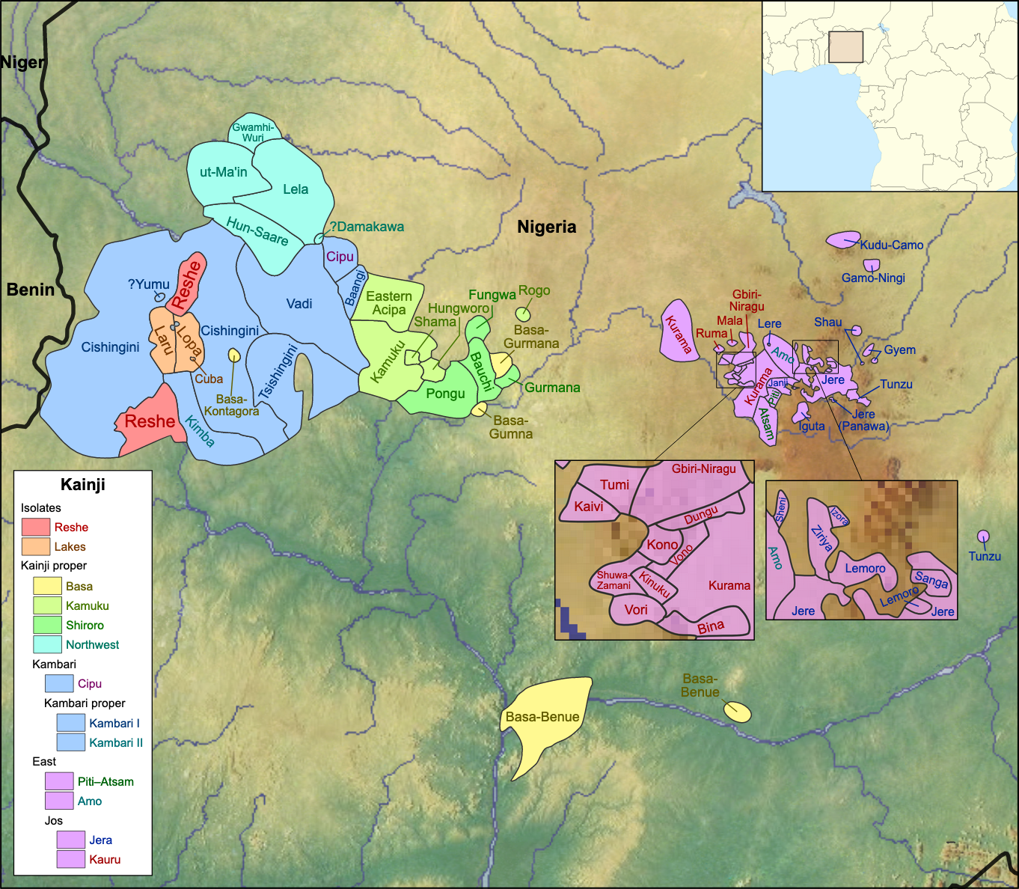
Location – Kainji Languages
Northwest Kainji
(McGill & Blench 2012 and Blench 2018)
U̱t-Maꞌin (aka Kag-Fer-Jiir-Koor-Ror-Us-Zuksun. Puku-Geeri-Keri-Wipsi, Fakkanci, Gelanci)
C’Lela (aka Dakkarkari)
u̱t-Hun / u̱s-Saare (aka Duka(wa))
Gwamhi-Wuri-Mba
Damakawa (moribund)
See McGill & Blench (2012) for a state of the art on Kainji languages.
Map image credit: CC BY-SA 4.0; https://en.wikipedia.org/wiki/Kainji_languages#/media/File:Map_of_the_Kainji_languages.svg
By User:SUM1 - Used in background Map Library satellite imagery and SRTM relief data from maps-for-free.com. Used international borders from File:Nigeria location map.svg by User:Uwe_Dedering. Used in zoom map File:Africa_map_blank.svg by User:Sting. Based design on File:Map_of_the_Niger-Congo_and_Khoisan_languages.svg by User:Alphathon.Language info: Ethnologue, CC BY-SA 4.0, https://commons.wikimedia.org/w/index.php?curid=61250956
Notes:
There are five languages provisionally classified as Northwest Kainji. Names of languages.
Map image credit: CC BY-SA 4.0; https://en.wikipedia.org/wiki/Kainji_languages#/media/File:Map_of_the_Kainji_languages.svg
By User:SUM1 - Used in background Map Library satellite imagery and SRTM relief data from maps-for-free.com. Used international borders from File:Nigeria location map.svg by User:Uwe_Dedering. Used in zoom map File:Africa_map_blank.svg by User:Sting. Based design on File:Map_of_the_Niger-Congo_and_Khoisan_languages.svg by User:Alphathon.Language info: Ethnologue, CC BY-SA 4.0, https://commons.wikimedia.org/w/index.php?curid=61250956

Slide 5
Some typological features of U̱t-Maꞌin, a NW Kainji Language
Constituent order (Paterson 2019):
S V (O₁ ) (O₂)
S Aux V (O₁) (O₂) – 15+ Aux encode Tense, Aspect, Modality, Polarity and more
S Aux (O₁) V (O₂) – limited to nɔm ‘do’ auxiliaries; V is in nominalized form.
Primary object (O₁) used for patient in transitive clauses and recipient in ditransitive clauses; secondary object (O₂) used for theme in ditransitive clauses.
O₁ position used for Reported Listener; O₂ position used for Speech Reports.
Prefixing and suffixing (Hoffmann 1967; Good 2018)
Derivational verbal suffixes (akin to Bantu verbal extentions) (McGill & Blench 2012)
Noun class language with concord agreement on many targets
“Striking reduction of nominal prefixes to a single consonant” (Blench*)
Notes:
*Add reference to http://www.rogerblench.info/Language/Niger-Congo/BC/Kainji/Northwest/NWOP.htm OR find statement in McGill & Blench (2012)??
I would argue that there is no indexing of arguments on verbs.

Slide 6
Data
Audio corpus
6+hrs total
25+ speakers, 7 varieties/dialects
Field recordings from 2005, 2007, 2013, 2017
Various genre – folk narrative, personal narrative, pear stories, conversations, songs
Written corpus
Words: 60,000+
Spellings follow Ror variety
Edited/crafted materials: e.g., literacy materials and translated portions of the Bible

Slide 7
U̱t-Maꞌin Reported Speech Constructions
Notes:
I believe that the key to understanding the nominative marking in U̱t-Maꞌin requires an understanding of the U̱t-Maꞌin Associative marker. I use the label Associative following Welmers (1963: 432; 1973: 275). This linking morpheme is variously called “genitive”, “connective”, “connexive” Van de Velde’s (2013: 217). The U̠t-Ma’in associative constructions parallel Van de Velde’s (2013: 246-247) Bantu connective construction:
i. two nominal constituents are in a relation of dependency
ii. the dependent nominal follows the head nominal
iii. the dependent nominal is marked by a dedicated connective relator (U̠t-Ma’in ASSOC), which agrees with the head nominal
iv. the connective construction is not only dedicated to the expression of possession, nor to any other [particular] relation

Slide 8
Terminology and abbreviations
Speech word: often the verb of speaking, verb phrase, or ɘ̄zɘ̄ morpheme; bolded throughout examples.
[… ]_{M} : marks right edge of Discourse Reporting Event (M for Matrix)
Report: the speech being reported; marked in purple throughout examples.
# : marks prosodic boundary - extended pause or shift in intonation
RS: reported speaker
RL: reported listener

Slide 9
‘say’ construction: zɘ̄ + Report
S V (O₁ ) (O₂) → [RS zɘ̄ (RL₁ )]_{M} (#PAUSE/PITCH) (Report)
Monoclausal
RL in O₁ position
Report in O₂ position
If no RL, Report in O₁ position
There can be a #_{PAUSE} and/or #_{PITCH} shift preceding a Report.
Notes:
Report can contain any person/number pronouns.

Slide 10

1)
a. kɘ́nàː #_{PAUSE} nā wɔ́ʔɔ́tɔ̀ ū-kɔ̄ʔtínkɔ̄
there npers put.pft c7-shrike(k.o.bird)
b. wā hɘ́ wá gɘ̄p ɘ̄t-káp
ag1.sbj go ag1.obj beat c6-wing
c. wā zɘ̄ #_{PITCH ↑} tʰíkʰɔ́ tʰíkʰɔ́ tʰíkʰɔ́ tʰíkʰɔ́ AG1.SBJ say shrike.call shrike.call shrike.call shrike.call
d. kɔ́wān-ɘ̀ há-ɘ̄n-ɛ́ r-bɘ̄n d-ɘ̀=s-hɛ́w (x 3)
everyone-c2.sbj go-dist-foc c5-gathering ag5-assoc=c4-dancing
e. #_{PITCH ↓} ìyā wā kɘ̄n-tɛ̀ kɔ́ː
like.that ag1.sbj cry-pft tag.q\Hausa
‘So then Ko̱tinko̱ was chosen. He goes to beat his wings. He says, “Tiko̱, tiko̱, tiko̱, tiko̱, tiko̱, tiko̱. Everyone come for the dancing celebration! Everyone come for the dancing celebration! Everyone come for the dancing celebration! ” That’s how he has cried, right?’ (GF_IT_Jiir_2007: 010-011)
Notes:
Example to show context and to share a bit of the art of these stories. Speech verb is in bold. Report is in purple. Speaker “voices” the characters speech, such that there is a change in pitch for the Report, identifying the reported speech. This is commonly the case. In this example, there is no explicit Addressee/RL.

Slide 11
‘say’ construction
Discourse Reporting Event + Report
nā=zɘ̄ jān-ɔ́ w=ɔ́ʔt ɘ̄s-kán
indef.subj=say what-c3 c1.subj=have c4-crying
‘Someone asked, “Why are you crying?” ’
(lit: “they say, what he have crying?”)
(YM_IY_Ror_2013: 007)
2)

Slide 12
‘say’ construction (with RL in M)
[RS=say]_{M} #_{Pitch} Report
[wā=zɘ̄ ]_{M} [ʃág-n =mɛ́ tʃán-ú=ró ]_{R}
ag1.subj say lend-dist=1sg.obj feather-c7=2sg.poss
‘(If he reaches that one), he (will) say “Loan me your feather”.’ (GF_IT_Jiir_2007: 034)
[RS=say RL]_{M} #_{Pitch} Report
[wɘ̄n zɘ̄ kʷárɘ́g]_{M} [ ʃág-n=mɛ́ tʃán-ū=ró ]_{R}
3sg say bush.fowl lend-dist=1sg.obj feather-c7=2sg.poss
‘(He reached the place of the bush fowl), he says to the bush fowl “Loan me your feather”.’
(GF_IT_Jiir_2007: 037)
3)
4)
Notes:
An Addressee can occur with zɘ̄. Compare # with # .

Slide 13
‘say-foc’ construction
5)
dà-ú kwɘ̄mb-rɘ̀ zɘ́-jɛ́ #_{PAUSE} [song]
time-c3 okra-c5.sbj say-foc [song]
‘That time the okra said “[song...]”
(OK_MI_2013: 028-029)
Notes:
An Addressee can occur with zɘ̄. Compare # with # .

Slide 14
Distribution of forms of zɘ̄ ‘say’
Form of ‘say’ | # in 100 page sample | # with REPORT | # occurring with ɘ̄zɘ̄
zɘ̄ ‘say’ | 250 | 240 | 0
zɘ̄-ɘ̄g ‘say-pst’ | 72 | 18 | 0
zɘ̄-ɘ̄t/zɘ̄-tɛ̀ ‘say-pft’ | 32 | 19 | 1
zɘ̄-jɛ̀ ‘say-foc’ | 59 | 11 | 0
ɔ́ =t-zɘ̄ ‘prog.aux=c6-say’ | 19 | 15 | 0
ɔ́-g =t-zɘ̄ ‘prog.aux-pst=c6-say’ | 8 | 8 | 0
dɛ́ =t-zɘ̄ ‘fut=c6-say’ | 7 | 2 | 0
ɘ̄zɘ̄ ‘saying’ | 875 | 94 | n/a
Notes:
/ɘ̄tzɘ̄/ → [ɘ̄zːɘ̄] OR [ɘ̄ʔzɘ̄]

Slide 15
Speech Verb Phrase + ɘ̄zɘ̄ construction
S V (O₁ ) (O₂)
[RS V (RL₁ )]_{M} ɘ̄zɘ̄ (#PAUSE/PITCH) (Report)
Monoclausal??
RL in O₁ position
Report in O₂ position
If no RL, Report in O₁ position
There can be a #_{PAUSE} or #_{PITCH} shift preceding a Report and following ɘ̄zɘ̄.
A note on the form of nominalized ‘say’: /ɘ̄t-zɘ̄/ → [ɘ̄zːɘ̄] OR [ɘ̄ʔzɘ̄]

Slide 16
Speech Verb Phrase + ɘ̄zɘ̄ Cxn
Discourse Reporting Event + ɘ̄zɘ̄ + Report
a. dá ná shítɘ̀ wɘ̄n ɘ̄zɘ̄
time indef.subj ask 3sg saying
b. wɘ̄ná hjànɛ́ ɘ́ ís-ɘ̄r=ró à
who? see.foc with eye-c5=2sg.poss q
‘then they asked him saying “Did you see it yourself?”
(GK_IY_Ror_2013: 038-039)
6)

Slide 17
ɘ̄zɘ̄ ‘saying’ is attested before REPORTS introduced by the following verbs (counts from 100 page sample):
‘tell’ (24)
‘ask’ (17)
‘beg’ (6),
‘call-out’ (4)
‘call’ (3)
‘shout’ (3)
‘remember’ (1)
‘rebuke’ (1)
‘instruct’ (1)
‘promise’ (1)
‘swear.oath’ (1)
‘accuse’ (1),
‘say’ (1)
‘hear’ (1)
‘do debate’ (3)
‘do talking’ (7)
‘do riddle’ (1)
‘do story’ (3)
‘do prayers’ (1)
‘do announcement’ (1)
‘do abuse’ (2)
‘start talking’ (1)
‘do warning’ (4)
‘do prophesy’ (1)
‘send’ (3)
‘desire’ (1)
‘worry’ (1)
‘go surprised’(1)
‘wrote’ (8) - always in the past tense, quoting written source
Notes:
ɘ̄zɘ̄ is not identical to the nominalized form on ɘ̄t-zɘ̄ [ɘ̄ʔzɘ̄] or [ɘ̄zːɘ̄]

Slide 18
Distribution of forms of wàr ‘tell’ + ɘ̄zɘ̄
Form of ‘tell’ | # in 100 page sample | # with REPORT | # occurring with ɘ̄zɘ̄
wàr(ɘ̀) ‘tell’ | 246 | 6 | 6
wàr-ɛ́ ‘tell-foc’ | 51 | 15 | 15
wár-ɘ́g ‘tell-pst’ | 20 | 1 | 1
wàr-ɘ̄n ‘tell-dist’ | 9 | 1 | 1
wàr-tɘ̀. ‘tell-pft’ | 3 | 0 | 0
wár-g-ɛ́ ‘tell-pst-subj.foc’ | 1 | 1 | 1

Slide 19
zɘ̄ ‘say’ > ɘ̄zɘ̄ ‘saying’ complement (Report)
7)
a. wā nòm ɘ̄msékʰ ɘ̄zɘ̄ #_{PAUSE}
ag1.foc do.aux c6b-riddle saying
b. # _{PITCH ↑} mɛ́ ɔ́ fándárnàkʰí
1sg.foc cop chameleon
‘He did a riddle saying, "Me, I am chameleon…
(whatever you are, I was…)” ’
(SFC_IT_Jiir_2007: 044-045)
Comments
Pause follows ɘ̄zɘ̄.
Pitch adjustment precedes Report.

Slide 20
An aside: Change in word order
S V O_{1.} O₂
[RS V RL]_{M} ɘ̄zɘ̄ (#PAUSE/PITCH) Report
‘e.g., they ask him saying quote’
S Aux V O_{1.} O₂
[RS Aux [V RL]_{VP}]_{M} ɘ̄zɘ̄ (#PAUSE/PITCH) Report
‘e.g., they will ask him saying quote’
S Aux O₁ V O₂???/ parallel clause
[RS nɔ́m RL V]_{M} (#PAUSE/PITCH) ɘ̄zɘ̄ Report
‘e.g., they warn him saying quote’

Slide 21
Güldemann (2008) on grammaticalization
quote > complement > purpose > reason and/or condition > other
Güldemann (2008: 523)

Slide 22
Extended uses of ɘ̄zɘ̄ in U̱t-Maꞌin
Complement (report) >
(see slide 17)
Complement (content of speaking) >
‘talked about…[clause]’
Complement (thinking/sensing)
‘know/think/agree/remember/boast/see/hear that…’
Complement (intention/result) >
‘in order to…’ / ‘with the result that…’
Subordinator!?! (reason) >
‘because…’
Complement (hypothetical condition?)
‘suppose that…’
quote > complement > purpose > reason and/or condition > other (Güldemann 2008: 523)
Notes:
I avoid the label “purpose” because there is another “purpose clause” in [gel], related to a future construction. ɘ̄zɘ̄ is not involved.
The fact that remɘ̄zɘ̄ has a subordinator function, makes me question the status of all ɘ̄zɘ̄ intro-ed clauses.
ɘ̄zɘ̄ ‘comp’ occurs with various non-speech verbs:
‘know’ (54+8), ‘think’ (9), ‘love’ (5), ‘agree’ (4), ‘remember’ (4), ‘hear’, ‘teach’ (14+8+), ‘boast’, ‘see’

Slide 23
Complement (report) > Complement (content of speaking)
8)
a. ɛ̄ nɔ́m-ɘ́g ī-nān i= ̀ =s-rém
c2.subj do-pst cDim-argument. agDim=assoc=c4-talking
b. #_{PAUSE} ɘ̄zɘ̄ wábā m-hā-ɘ̄n ɘ́= dà-ù únɔ̀
saying first.one c6b-go-dist loc=time-c3 dem.c3
‘They did a debate saying who was the first to come at that time.’ (SFC_IT_Jiir_2007: 001-004)
Comments
Event preceding ɘ̄zɘ̄ is still speech related.
Slight pause precedes ɘ̄zɘ̄; no pause after ɘ̄zɘ̄; no pitch adjustment.

Slide 24
Complement (thinking/sensing)
nɛ̄t t-ɘ̀ há-ːn-ɛ́ r-tàkɘ̀n] tʃɘ́ŋ ɘ̄zɘ̄…[thought]
person c6-rel go-dist-foc c5-beginning think.pst saying
‘People who came first thought that...[thought]’
(MT_draft_2019: 20.10)
ɘ̄m nák ɘ̄zɘ̄ nú-ú=rí ɔ́
1sg.subj know.pst that mouth-c3=1sg.poss def.ag3
‘I know it is my fault’ (SR_SJ_Ror_2013: 011)
9)
10)

Slide 25
Complement (intention/result)
Look in order to…
Finish with the result that…
Sacrifice so that…
Leave him so that…
Note: Needs more careful investigation.

Slide 26
Subordinator!?! (reason)
rēm + ɘ̄zɘ̄ → rēmɘ̄zɘ̄
a. ɘ̄r-rém [ɘ̄lːém]
c5-tongue
b. ɘ̄t-rém
c6-tongue
c. ɘ̄s-rém
c4-talking
gòŋgū=d-ɘ̀=s rém
drum=ag5-assoc=c4-talking
‘talking drum’
Form | # in sample | # with REPORT
ɘ̄zɘ̄ ‘saying’ | 875 | 94
rēmɘ̄zɘ̄ | 193 | 0

Slide 27
rēm ‘words/talking’ + ɘ̄zɘ̄
11)
rém=ɘ̄zɘ̄=m hɘ́-ːt=ɘ́t bàks ɘ́=bɔ̄=nɛ̀
word=say=1sg go-pft=c6 remembering loc=2sg=with
‘ “...because I always remember you.” ’ (MA_IY_Ror_2013: 011)
Comments
Seems to be a clear subordinator.
No pause before or after ɘ̄zɘ̄; no pitch adjustment on complement.

Slide 28
Complement (hypothetical condition?)
‘Suppose that…[situation] / (It is) better that…[situation]’
(Lit: get.pst ɘ̄zɘ̄)
Other (???)
‘(It) means…[definition] ’
(Lit: sit.imp ɘ̄zɘ̄)
Note: Both of these need more careful investigation.

Slide 29
References
Blench, Roger. 2018. Nominal affixing in the Kainji languages of northwestern and central Nigeria. In John R. Watters (ed.), East Benue-Congo: Nouns, pronouns, and verbs. Berlin: Language Science Press.
Gerhardt, Ludwig. 1989. Kainji and Platoid. In John Bendor-Samuel (ed.), The Niger-Congo languages, 359-76. Lanham: University Press of America.
Good, Jeff. 2018. East Benue-Congo noun classes, with a focus on morphological behavior. In John R. Watters (ed.), East Benue-Congo: Nouns, pronouns, and verbs. Berlin: Language Science Press.
Güldemann, Tom. 2008. Quotative indexes in African languages: a synchronic and diachronic survey (Empirical Approaches to Language Typology [EALT] 34). Berlin; New York: Mouton de Gruyter. https://doi.org/10.1515/9783110211450
Hoffmann, Carl. 1967. An outline of the Dakarkari noun class system and the relation between prefix and suffix noun-class systems. La classification nominale dans les langues négroafricaines, ed. G. Manessy, 237-259. Paris: CNRS.
International Organization for Standardization (ISO). (2007). ISO 639-3:2007:Codes for the representation of names of languages -- Part 3:Alpha-3 code for comprehensive coverage of languages. Geneva, Switzerland: International Standards Organization. https://www.iso.org/standard/39534.html; as amended through 2019 by the ISO 639-3 registrar, SIL International.
McGill, Stuart & Roger M Blench. 2012. Documentation, Development, and Ideology in the Northwest Kainji Languages. (Ed.) Peter K Austin & Stuart John McGill. Language Documentation and Description 11. London. 90–135.
Paterson, Rebecca Dow Smith. 2019. Nominalization and Predication in U̱t‑Ma'in. PhD Dissertation, University of Oregon. Available online: https://scholarsbank.uoregon.edu/xmlui/handle/1794/25259
Watters, John R. 2018. East Benue-Congo. In John R. Watters (ed.), East Benue-Congo: Nouns, pronouns, and verbs. Berlin: Language Science Press.

Slide 30
Thank you!

